Slide 1





































































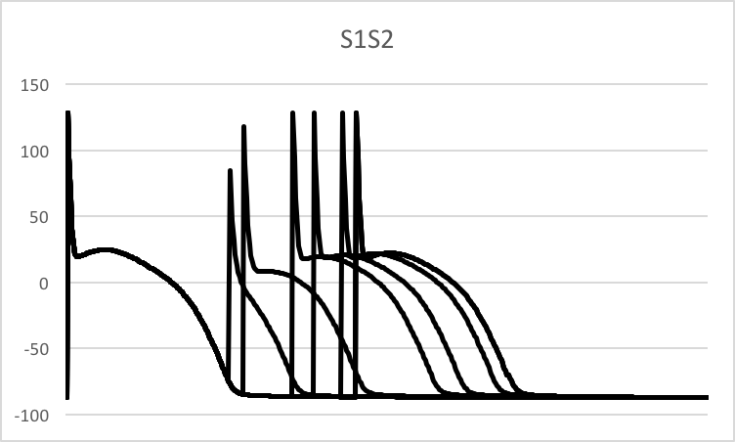
























Nonlinear Dynamics involving Action Potential Duration
in Relation to Cardiac Arrhythmias
Jessica Au¹ and Daisuke Sato²
¹Department of Mathematics, University of California, Davis 95616
²Department of Pharmacology, University of California, Davis 95616
Introduction
Results: Effects of Ca²⁺ Channel Conductance
Generation of Spiral Waves
Sudden Cardiac Death is one of the leading causes of deaths in the United States and is known to be caused by abnormalities of heart rhythm, or cardiac arrhythmias. The leading cause of sudden cardiac death is due to ventricular fibrillation (VF). VF is associated with a spatiotemporally disorganized electrical activity that prevents the ventricles from pumping blood to the body. Understanding the mechanisms of VF and its precursors is critical for developing effective therapies. Using mathematical modeling of a rabbit ventricular cell and tissue, we investigated how the change in properties of ion channels such as conductance, affects instabilities of action potential waves at the tissue level.
We initiated a spiral wave by using a cross-field stimulation onto the 2D tissue (Fig 3). We used a 1000 by 1000 (~15 cm × 15 cm) array to model the ventricular wall tissue, where one element within this array represents a single cell.
Figure 3 : Cross-field stimulation
0 ms
45 ms
90 ms
135 ms
180 ms
225 ms
Decreasing the conductance to 40%, we find the slope of the APD restitution curve is much shallower compared to when the conductance is not altered. The 2D images show that there is a consistent spiral wave, displaying signs of ventricular tachycardia.
Decreasing the conductance to 70%, we find the slope of the APD restitution curve is shallower than when the conductance is not altered. The 2D images show the break up of the initial spiral wave and its termination.
When the conductance is not altered, hence 100%, we find the complete breakup of the spiral wave that was initiated. Eventually, the spiral wave disappeared. We will treat this as the control.
Increasing the conductance to 150%, we find the slope of the APD restitution is steeper than the non-altered conductance. The 2D images show the consistent reentry of the initial spiral wave, displaying signs of ventricular fibrillation.
270 ms
315 ms
339 ms
360 ms
405 ms
450 ms
Conclusions
We showed that the steepness of the APD restitution curve correlates to the appearance of spiral wave break-ups. We demonstrate that by using nonlinear dynamics, we can theoretically predict susceptibility to arrhythmias in patients from the single cell property (i.e. steepness of APD restitution curve).
Methods: S1S2 &
Action Potential Duration (APD) Restitution Curve
Results: Effects of K⁺ Channel Conductance
APD restitution is the relationship between APD at beat n+1 and the diastolic interval (DI) at beat n (Fig 1). To find the APD restitution curve, we used the S1S2 protocol shown in Fig 2. The myocyte is paced with many beats (S1) and then with a premature stimulus (S2) to see the response of APD to DI. In other words, to find APD, we altered the coupling interval (S2) between two consecutive beats to change DI.
Future Directions
We list the following Anti-arrhythmic drugs that are considered in these cases:
Class I: Na⁺ channel blockers.
Example: Quinidine, Procainamide.
Class III: K+ channel blockers.
Example: Sotalol
Class IV: Ca²⁺ channel blockers.
Example: Verpamil
In this study we simply varied the conductance of different ion channels. In our future study, we will model and simulate interactions between these ion channels and drugs.
Decreasing the conductance to 60%, the slope of the APD restitution curve is steeper than when the conductance is not altered. The 2D images show that the initial spiral wave breaks up completely.
When the conductance is not altered, hence 100%, we find the complete breakup of the spiral wave that was initiated. We will treat this as the control.
Increasing the conductance to 130%, the slope of the APD restitution curve is shallower than when the conductance is not altered. The 2D images show a consistent reentry of a spiral wave, which is a sign of ventricular fibrillation
Increasing the conductance to 180%, the slope of the APD restitution curve is shallower than when the conductance is not altered. The 2D images show a consistent reentry of the spiral waves, which is a sign of ventricular fibrillation.
Figure 1
Results: Effects in Na⁺ Channel Conductance
Voltage (mV)
20
PCL
-80
APD_{n}
DI_{n}
APD_{n+1}
Figure 2
Time
References
Voltage (mV)
S1
S2
“A Rabbit Ventricular Action Potential Model Replicating Cardiac Dynamics at Rapid Heart Rates.” Mahajan A1, Shiferaw Y, Sato D, Baher A, Olcese R, Xie LH, Yang MJ, Chen PS, Restrepo JG, Karma A, Garfinkel A, Qu Z, Weiss JN. Biophys J. 2008 Jan 15;94(2):392-410.
“Preventing Ventricular Fibrillation by Flattening Cardiac Restitution.” Garfinkel A1, Kim YH, Voroshilovsky O, Qu Z, Kil JR, Lee MH, Karagueuzian HS, Weiss JN, Chen PS. Proc Natl Acad Sci U S A. 2000 May 23;97(11):6061-6
Decreasing the conductance to 50%, the slope of the APD restitution curve is slightly steeper than when the conductance is not altered. The 2D images show the consistent reentry of initiated the spiral wave.
When the conductance is not altered, hence 100%, we find the complete breakup of the spiral wave that was initiated. We will treat this as the control.
Increasing the conductance to 150%, the slope of the APD restitution curve is slightly steeper than when the conductance is not altered. The 2D images show the complete break up of the spiral wave that was initiated, this occurred at a faster rate.
Increasing the conductance to 200%, the slope of the APD restitution curve is slightly steeper than when the conductance is not altered. The 2D images show the complete break up of the spiral wave that was initiated, this occurred at a much faster rate.
Time

